Slide 1
Cornerstone City Church Peninsula Plus Community Hoo Are Ya
29th October 2023

Slide 2


Slide 3
The Butterfly Song CCLI Song # 35445
Brian Howard
© 1975 Mission Hills Music (Admin. by Song Solutions www.songsolutions.org)
For use solely with the SongSelect® Terms of Use. All rights reserved. www.ccli.com
CCLI Licence No. 33265

Slide 4
1/4
If I were a butterfly
I'd thank You Lord for giving me wings
If I were a robin in a tree
I'd thank You Lord that I could sing
If I were a fish in the sea
I'd wiggle my tail and I'd giggle with glee
But I just thank You Father for making me, me

Slide 5
2/4
For You gave me a heart
And You gave me a smile
You gave me Jesus
And You made me Your child
And I just thank You Father
For making me, me
(REPEAT)

Slide 6
3/4
If I were an elephant
I'd thank You Lord by raising my trunk
If I were a kangaroo
You know I'd hop right up to You
If I were an octopus
I'd thank You Lord for my fine looks
But I just thank You Father for making me, me

Slide 7
4/4
If I were a wiggly worm
I'd thank You Lord that I could squirm
And if I were a fuzzy wuzzy bear
I'd thank You Lord for my fuzzy wuzzy hair
If I were a crocodile
I'd thank You Lord for my great smile
But I just thank You Father for making me me

Slide 8
Glorious Day
CCLI Song # 7081388
Jason Ingram | Jonathan Smith | Kristian Stanfill | Sean Curran
© 2017 KPS 1.0 (Admin. by Capitol CMG Publishing)
sixsteps Music (Admin. by Capitol CMG Publishing)
sixsteps Songs (Admin. by Capitol CMG Publishing)
Sounds Of Jericho (Admin. by Capitol CMG Publishing)
Worship Together Music (Admin. by Capitol CMG Publishing)
worshiptogether.com songs (Admin. by Capitol CMG Publishing)
Fellow Ships Music (Admin. by Essential Music Publishing LLC)
Hickory Bill Doc (Admin. by Essential Music Publishing LLC)
So Essential Tunes (Admin. by Essential Music Publishing LLC)
For use solely with the SongSelect® Terms of Use. All rights reserved. www.ccli.com
CCLI Licence No. 33265

Slide 9
1/6
I was buried beneath my shame
Who could carry that kind of weight
It was my tomb 'til I met You

Slide 10
2/6
I was breathing but not alive
All my failures I tried to hide
It was my tomb 'til I met You

Slide 11
3/6
('Cause when) You called my name (and)
I ran out of that grave
Out of the darkness into Your glorious day
You called my name (and) I ran out of that grave
Out of the darkness into Your glorious day

Slide 12
4/6
Now Your mercy has saved my soul
Now Your freedom is all that I know
The old made new Jesus when I met You

Slide 13
5/6
I needed rescue my sin was heavy
But chains break at the weight of Your glory
I needed shelter I was an orphan
Now You call me a citizen of Heaven
When I was broken You were my healing
Now Your love is the air that I'm breathing
I have a future my eyes are open

Slide 14
6/6
('Cause when) You called my name (and)
I ran out of that grave
Out of the darkness into Your glorious day
You called my name (and)
I ran out of that grave
Out of the darkness into Your glorious day

Slide 15
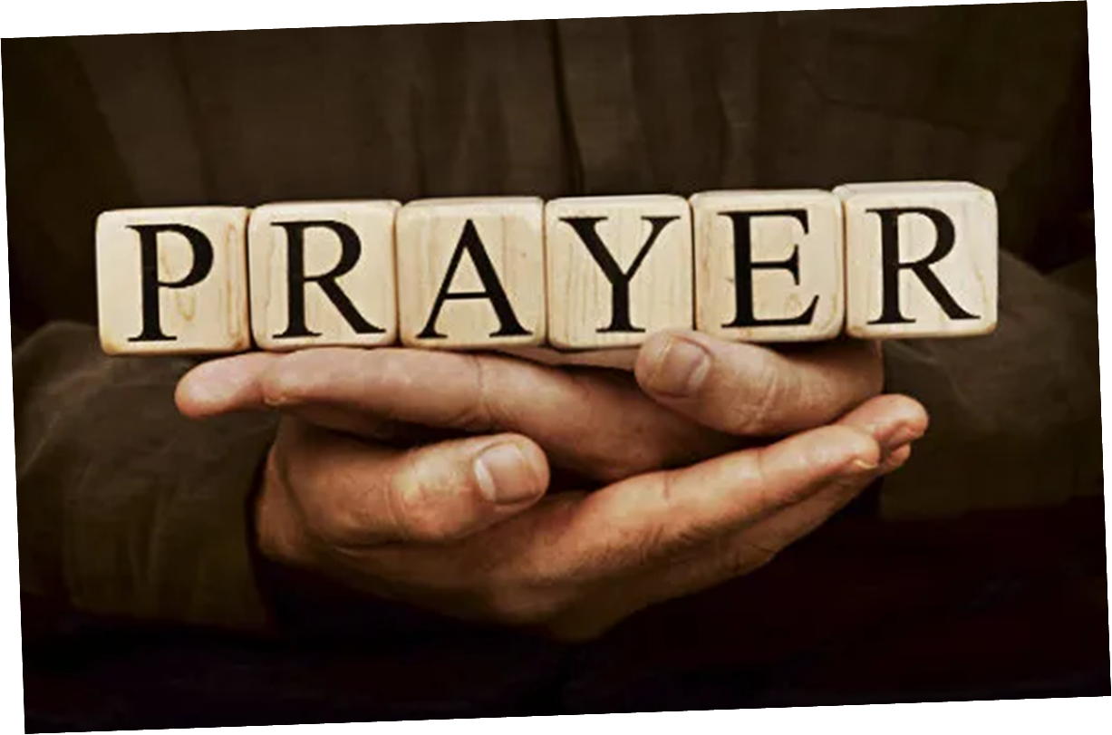

Slide 16
House Of The Lord
CCLI Song # 7168995
© 2020 Phil Wickham MusicSimply Global SongsBe Essential SongsCashagamble Jet Music
For use solely with the SongSelect® Terms of Use. All rights reserved. www.ccli.com
Note: Reproduction of this sheet music requires a CCLI Music Reproduction Licence. Please report all copies.
CCLI Licence No. 33265

Slide 17
1/5
We worship the God who was
We worship the God who is
We worship the God who evermore will be
He opened the prison doors
He parted the raging sea
My God He holds the victory yeah

Slide 18
2/5
There’s joy in the house of the Lord
There’s joy in the house of the Lord today
And we won’t be quiet
We shout out Your praise

Slide 19
3/5
There’s joy in the house of the Lord
Our God is surely in this place
And we won’t be quiet
We shout out Your praise

Slide 20
4/5
We sing to the God who heals
We sing to the God who saves
We sing to the God who always makes a way
'Cause He hung up on that cross
Then He rose up from that grave
My God’s still rolling stones away

Slide 21
5/5
We were the beggars
Now we’re royalty
We were the prisoners
Now we’re running free
We are forgiven accepted
Redeemed by His grace
Let the house of the Lord sing praise

Slide 23
House of Miracles
CCLI Song # 7158414
Brandon Lake | Jacob Sooter
© 2020 Just When Publishing; So Essential Tunes; Bethel Music Publishing; Brandon Lake Music; Maverick City Publishing Worldwide
For use solely with the SongSelect® Terms of Use. All rights reserved. www.ccli.com
CCLI License # 33265

Slide 24
1/5
This is a house of worship
This is a place of praise
Where every demon trembles
Where we proclaim Your name

Slide 25
2/5
This is a house of healing
Our hearts are full of faith
You have our full attention
You have the final say

Slide 26
3/5
Come alive in the name of Jesus
Come alive in the name of Jesus
This is a house of miracles
We bring everything to the feet of Jesus
Everything in the name of Jesus
This is a house of miracles

Slide 27
4/5
There’s resurrection power
Your blood runs through our veins
Your Kingdom triumphs over
Even the coldest grave

Slide 28
5/5
I still believe You’re moving
I still believe You’re speaking
God, I believe You’re working
All things for good
I fix my eyes on Heaven
God, I receive Your vision
God, I believe You’re working
All things for good

Slide 29
Battle Belongs
CCLI Song # 7148126
Brian Johnson | Phil Wickham
© Phil Wickham Music (Admin. by / Small Stone Media BV, Holland (Admin. in the UK/Eire by Song Solutions www.songsolutions.org))
Simply Global Songs (Admin. by / Small Stone Media BV, Holland (Admin. in the UK/Eire by Song Solutions www.songsolutions.org))
Bethel Music Publishing (Admin. by Song Solutions)
For use solely with the SongSelect® Terms of Use. All rights reserved. www.ccli.com
CCLI Licence No. 33265

Slide 30
1/4
When all I see is the battle
You see my victory
When all I see is a mountain
You see a mountain moved
And as I walk through the shadow
Your love surrounds me
There's nothing to fear now
For I am safe with You

Slide 31
2/4
So when I fight I'll fight on my knees
With my hands lifted high
O God the battle belongs to You
And every fear I lay at Your feet
I'll sing through the night
O God the battle belongs to You

Slide 32
3/4
And if You are for me
Who can be against me
For Jesus there's nothing
Impossible for You
When all I see are the ashes
You see the beauty
When all I see is a cross
God You see the empty tomb

Slide 33
4/4
(An) Almighty Fortress You go before us
Nothing can stand against
The power of our God
You shine in the shadows
You win every battle
Nothing can stand against
The power of our God

Slide 34


Slide 35
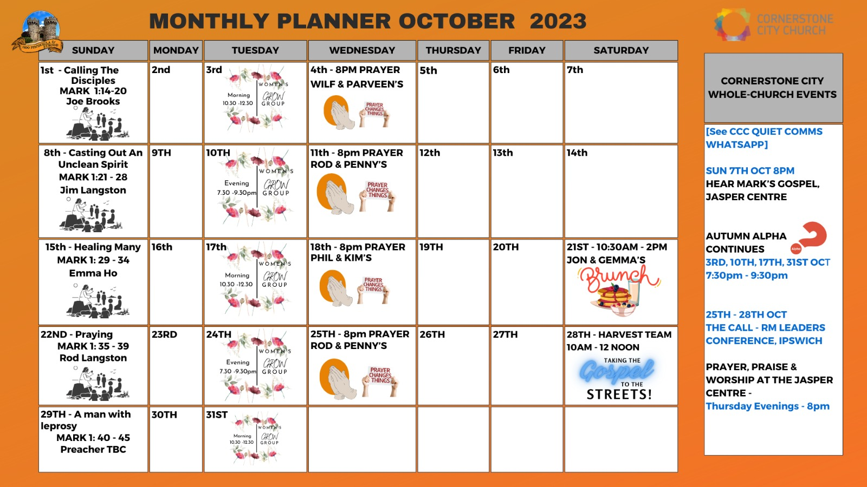

Slide 36


Slide 37
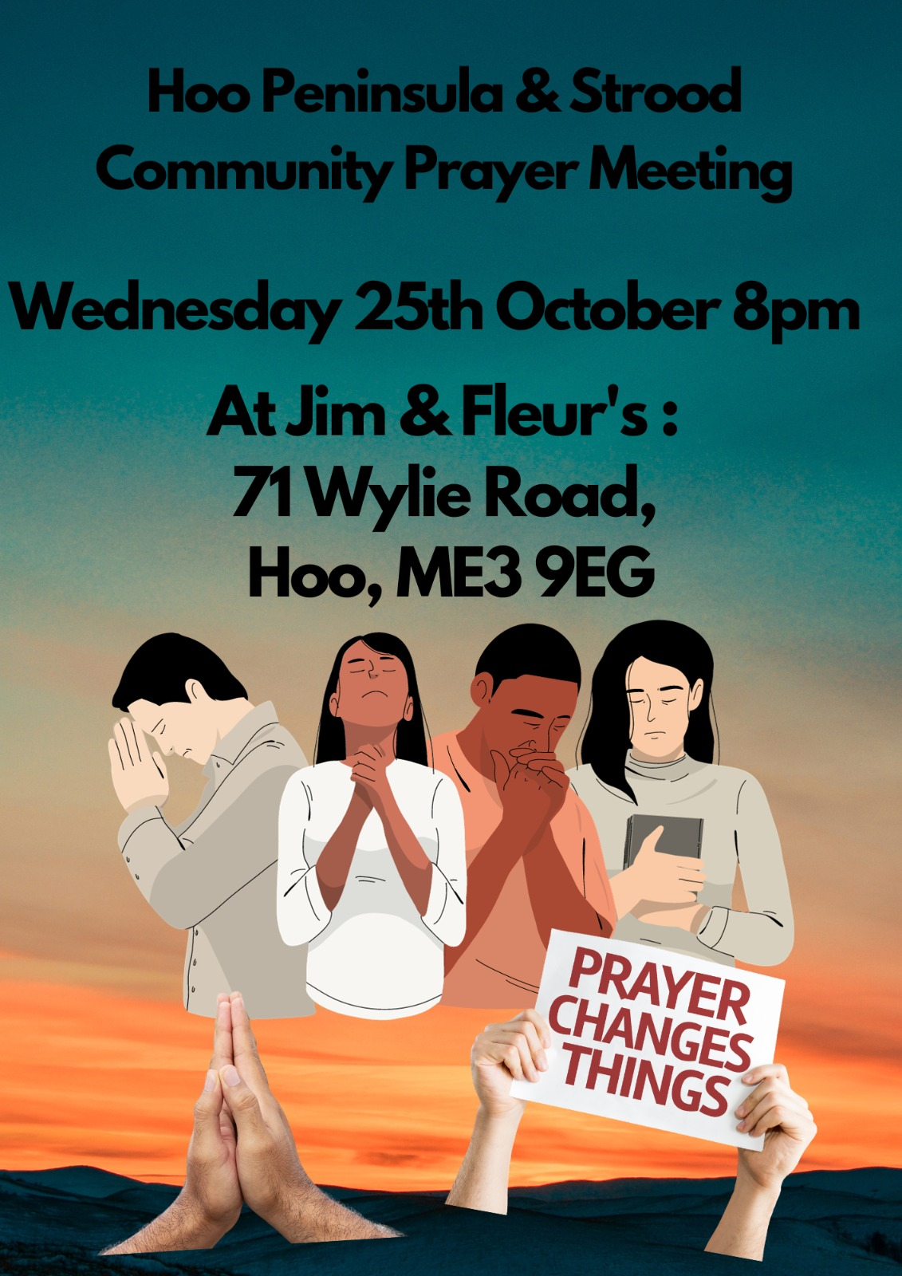

Slide 38


Slide 39


Slide 40


Slide 41


Slide 42
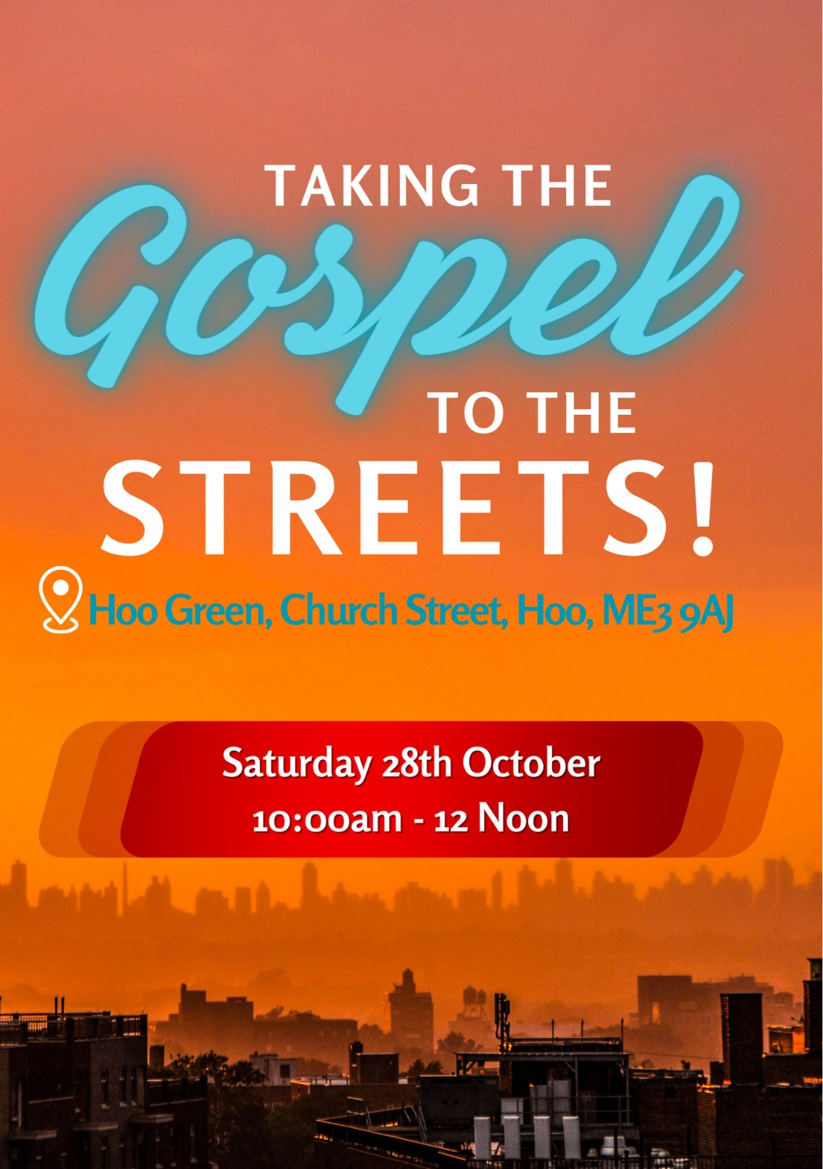

Slide 43


Slide 44
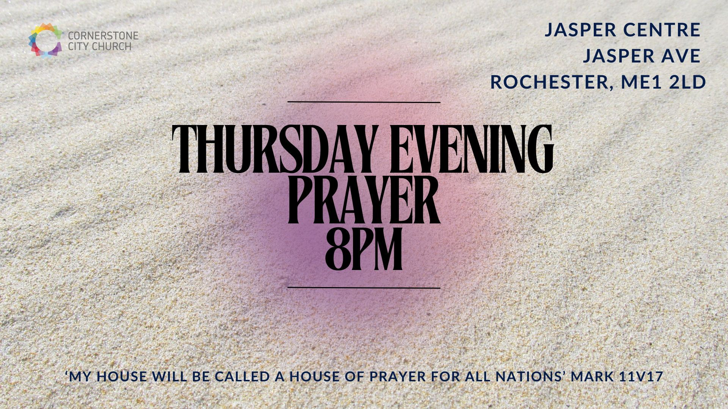

Slide 45


Slide 46


Slide 48
King Of Kings Majesty
CCLI Song # 1581778
Jarrod Cooper
© 1996 Sovereign Lifestyle Music
For use solely with the SongSelect® Terms of Use. All rights reserved. www.ccli.com
CCLI Licence No. 33265

Slide 49
1/3
King of kings majesty
God of heaven living in me
Gentle Saviour closest friend
Strong deliv'rer beginning and end
All within me falls at Your throne

Slide 50
2/3
Your majesty I can but bow
I lay my all before You now
In royal robes I don't deserve
I live to serve Your majesty

Slide 51
3/3
Earth and heav'n worship You
Love eternal faithful and true
Who bought the nations ransomed souls
Brought this sinner near to Your throne
All within me cries out in praise

Slide 52
2 Corinthians 14 May the grace of the Lord Jesus Christ, and the love of God, and the fellowship of the Holy Spirit be with you all

